Slide 1
SOFT COMPUTING · CASE STUDY
CNN Pruning Using Genetic Algorithms and Knowledge Distillation
Soft Computing – Case Study Presentation
Presented by: Bheeshma Shankar A
Roll Number: 160124748093
Department: CSE (Artificial Intelligence and Machine Learning)
College: Chaitanya Bharathi Institute of Technology (CBIT), Hyderabad
Notes:
Introduce the case study as a compression problem: search for useful channel reductions, then use knowledge distillation to help the smaller model retain the task.

Slide 2
JUSTIFICATION OF THE TITLE
Why this title fits the problem
CNNs provide effective image classification but may require significant computational resources.
Structured pruning removes selected channels to reduce model complexity.
Genetic Algorithms (GA) search for suitable channel-pruning configurations.
Knowledge Distillation (KD) transfers useful knowledge from a larger teacher model to a smaller student model.
The title reflects the combination of GA-based pruning and KD to balance model efficiency and accuracy.
Teacher CNN
GA-Based Pruning
Knowledge Distillation
Compressed Student CNN
Notes:
The title is descriptive. The Genetic Algorithm chooses pruning ratios, structured pruning changes the network, and Knowledge Distillation helps the student learn from the teacher.

Slide 3
FOUR OBJECTIVES
Parameter Reduction
Computational Efficiency
Reduce trainable parameters.
Reduce MACs.
PRIMARY OBJECTIVE
Reduce CNN model complexity while maintaining classification accuracy
Accuracy Preservation
Latency Evaluation
Maintain performance close to the original CNN.
Measure inference time before and after compression.
Notes:
The objective has four parts: parameter reduction, computational efficiency measured by MACs, accuracy preservation, and latency evaluation before and after compression.

Slide 4
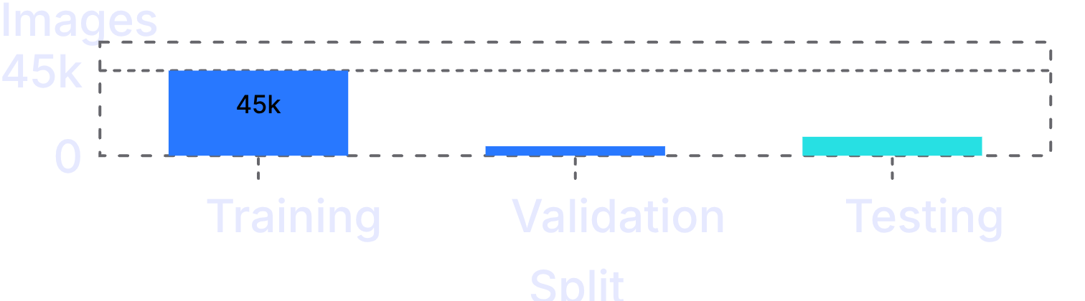
DATASET · CIFAR-10
THE TEN CLASSES
CIFAR-10 contains images from 10 classes
Classes 1–5 | Classes 6–10
Airplane | Dog
Automobile | Frog
Bird | Horse
Cat | Ship
Deer | Truck
Each image is a 32 × 32 colour image. The dataset contains 60,000 images divided into training, validation, and testing sets.
DATASET SPLIT
Total: 60,000 images
Notes:
CIFAR-10 contains ten image classes. Each image is a 32 × 32 colour image, and the dataset of 60,000 images is split into 45,000 training, 5,000 validation, and 10,000 testing images.

Slide 5
PROPOSED METHODOLOGY
WORKFLOW
Five steps combine search, pruning, and teaching
CIFAR-10
Teacher CNN
Train Teacher CNN — train the original CNN on CIFAR-10.
Genetic Algorithm — search for suitable channel-pruning ratios.
Construct Student CNN — build a smaller network using selected channels.
Knowledge Distillation — train the student using knowledge from the teacher.
Performance Evaluation — compare accuracy, precision, recall, F1-score, parameters, MACs, and latency.
Genetic Algorithm
Channel Pruning
Student CNN + KD
Performance Evaluation
Notes:
Read the workflow from left to right. The teacher CNN is trained on CIFAR-10, the Genetic Algorithm searches channel-pruning ratios, channels are pruned, and the student CNN is trained with Knowledge Distillation before evaluation.

Slide 6
IMPLEMENTATION · ARCHITECTURE
TEACHER-TO-STUDENT KD
Original CNN vs pruned student
Teacher CNN
Layer | Original CNN | Pruned student
Convolutional layer 1 | 32 channels | 28 channels
Convolutional layer 2 | 64 channels | 64 channels
Convolutional layer 3 | 128 channels | 94 channels
Fully connected layer | 256 units | 256 units
Original architecture
↓ Knowledge Distillation
Student CNN
Pruned architecture
GA selected the channel-pruning configuration; structured pruning reduced channels in selected layers; KD trained the smaller student model.
Both models were evaluated with classification and efficiency metrics.
Notes:
The student keeps the three convolutional stages. Conv1 changes from 32 to 28 channels and Conv3 from 128 to 94; Conv2 stays at 64. The fully connected layer has 256 units in both models.

Slide 7
EXPERIMENTAL RESULTS AND OUTPUT
ACCURACY
PARAMETERS AND MACS
Test metrics: original CNN vs GA Pruning + KD
79.33% → 79.00%: a 0.33 percentage-point decrease.
Parameters reduced by 25.99%.
MACs reduced by 19.29%.
Metric | Original CNN (M1) | GA Pruning + KD (M5)
Test accuracy | 79.33% | 79.00%
Macro precision | 0.7924 | 0.7905
Macro recall | 0.7933 | 0.7900
Macro F1-score | 0.7927 | 0.7899
Parameters | 620,810 | 459,436
MACs | 10.8488 million | 8.7557 million
Latency | 1.3488 ms/image | 1.6645 ms/image
LATENCY · INCREASED
Inference latency rose from 1.3488 ms to 1.6645 ms per image.
Notes:
Parameters fell by 25.99% and MACs by 19.29%, while test accuracy decreased by 0.33 percentage points. Measured latency increased from 1.3488 to 1.6645 milliseconds per image.

Slide 8
BENEFITS
TRADE-OFF
RESULTS ANALYSIS
Similar accuracy: 79.00% vs 79.33%.
Fewer parameters: 459,436 vs 620,810.
Fewer MACs: 8.7557 million vs 10.8488 million.
Smaller
is not always faster.
Lower complexity does not guarantee faster inference
Latency increased from 1.3488 to 1.6645 ms per image despite compression.
Hardware, memory access, implementation overhead, and runtime conditions can change the outcome.
Notes:
The student achieved similar accuracy with fewer parameters and MACs, but measured latency increased despite compression. Lower computational complexity does not automatically guarantee faster inference.

Slide 9
COMPLETED WORK
FUTURE SCOPE · PROPOSED, NOT COMPLETED
Conclusion
Proposed improvements
GA-based structured pruning reduced model parameters and computational operations.
KD helped maintain classification performance close to the teacher.
Test accuracy decreased slightly from 79.33% to 79.00%.
The student had higher measured inference latency despite reduced complexity.
Explore different pruning ratios and GA fitness functions.
Compare uniform pruning, Taylor-based pruning, and KD-only models.
Repeat experiments with multiple random seeds.
Test other CNN architectures and datasets.
Measure latency on CPU, GPU, and edge devices.
Investigate hardware-aware pruning for faster real-world inference.
Notes:
Completed work: GA-based structured pruning, KD, a slight accuracy decrease, and higher measured latency. Future scope lists proposed improvements that have not been carried out.

Slide 10
SOFT COMPUTING CASE STUDY
THANK YOU
CNN Pruning Using Genetic Algorithms and Knowledge Distillation
Bheeshma Shankar A | 160124748093
CBIT | CSE (AI & ML)
Notes:
Invite questions. If discussion begins, return to the central interpretation: the method achieved meaningful structural compression, but measured latency must be treated as a separate deployment result.

